Slide 2
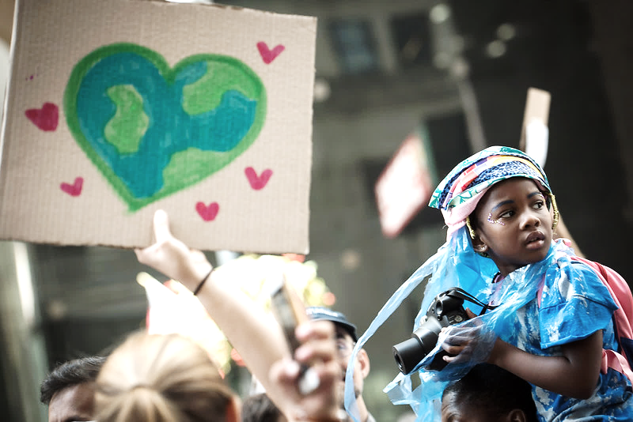
What is Environmental Justice?
Fair treatment and meaningful involvement of all persons
Regardless of race, color, national origin, or income
With respect to:
the development, implementation, and enforcement of environmental laws, regulations, policies, and activities
the distribution of environmental benefits
Notes:
To understand environmental justice (EJ), it is important to first understand environmental injustice. For far too long, communities with a majority of low-income residents, communities of color - often those with the least amount of power and contribution to environmental degradation - have experienced a disproportionate share of poor environmental outcomes.
Environmental justice works to address this by ensuring access and inclusion for people at every level of the planning and decision-making process, and equal protection from environmental and health hazards. This also includes implementing polices designed to close the gap on these environmental health disparities.
Climate justice is the recognition that it is these same historically overburdened communities that are most vulnerable to a rapidly changing climate. Disparities that are persistent in our society, from social, to economic and health inequities, can be exacerbated by impacts of climate change like extreme heat, flooding, and catastrophic weather events. The pursuit of climate justice also means holding those with the most responsibility for the climate crisis accountable.

Slide 3
NYC’s Environmental Justice Laws
Local laws 60 & 64 of 2017 codified environmental justice into City decision-making
Became law after 10 years of advocacy from grassroots environmental justice organizations and the leadership of elected officials including NYC Councilmembers Charles and Inez Barron and Costa Constantinides

Slide 4
NYC’s Environmental Justice Laws
Our roadmap to identify and address Environmental Justice concerns in NYC.
ASSESS
ASSEMBLE
ADDRESS
Identify EJ Areas and outline concerns through a study/report
Publish a web portal with EJ maps, data, and programs
Establish an Advisory Board of local leaders and experts
Convene a Working Group of City agencies
Develop a Citywide EJ Plan to:
Incorporate EJ concerns into City decision-making
Identify City initiatives for promoting EJ
Current step
Notes:
Make it clear that the town halls and public comments sits within the “Assess” section

Slide 5
How will public input shape this work?
Aug – Sept 2021
Provide comments on draft Scope
July – Sept 2022 Propose solutions for the EJ Plan
Feb – Apr 2021 Help develop the draft Report scope
Dec 2021 – Feb 2022 Feedback on the draft EJ Report
Jan – Mar 2023 Comment on the draft EJ Plan
5

Slide 6
Baking Environmental Justice into City Programs: NYC Accelerator
A City program to help boost building performance, increase energy savings, control costs, meet local law compliance, and reduce carbon emissions across NYC buildings
Guidance to help the market transform how our buildings operate and are built
No-cost technical assistance to all buildings over 5,000 square feet across NYC
The NYC Accelerator team identifies building upgrade projects to help meet emissions limits established under the Climate Mobilization Act
The NYC Accelerator also provides no-cost building operator trainings and supports green workforce development

Slide 7
NYC Accelerator & Environmental Justice
Targeted outreach to neighborhoods most impacted by climate change: Upper Manhattan & Central Brooklyn
Green workforce development
Internship program
Free online training
Program accessibility
Accessible content
To lean more visit: nyc.gov/accelerator
Notes:
NYC is committed to leading a just and equitable transition to carbon neutrality and acknowledges that environmental justice communities have borne a disproportionate share of the negative impacts associated with our existing economy.
NYC Accelerator’s values of equity, accountability, urgency, moving toward justice, transparency, and partnership support the City’s commitment to building a better future for all New Yorkers

Slide 8
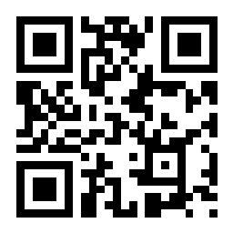
discuss.
Submit questions via slido.com
Code: #beex

Slide 9
thank you.

